Slide 1

McQuire Rens Global Consulting

Slide 2

What We Do

Slide 3

Coaching and Mentoring
Investigation leading to individual coaching
Mentoring
Executive Coaching
Capability Development
President, CEO Grooming
and Coaching

Slide 4
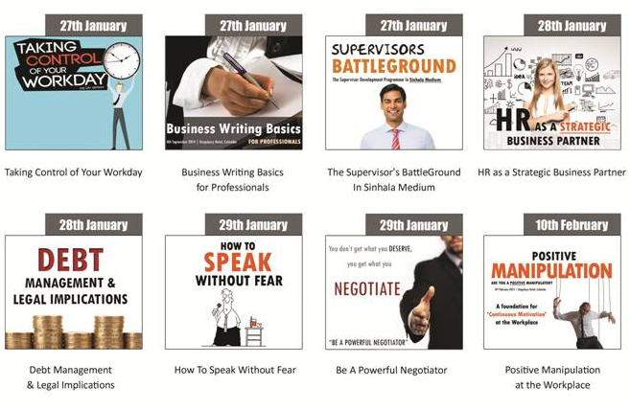
Public Seminars, Workshops and
In-House Training
400 plus programs per year

Slide 5
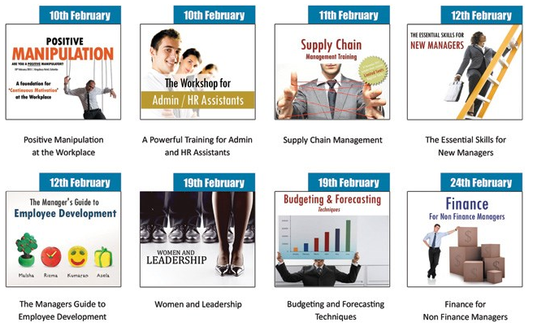
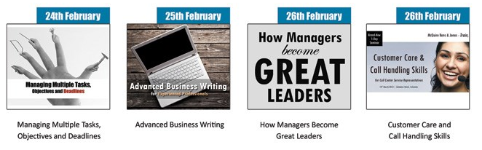

Slide 6
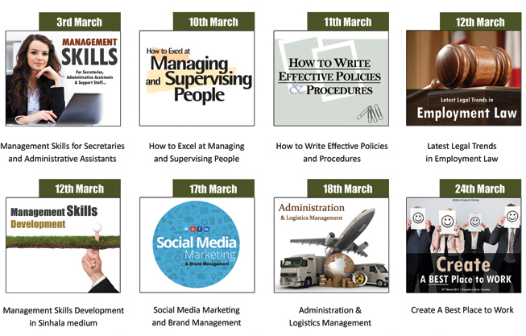
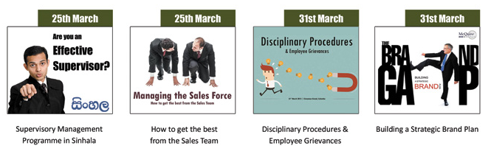

Slide 11

Research
Internal Research within the company
Employee Opinion Survey (Online as well as Manually)
Interdepartmental Trust/Perception Survey
Customer Perception Survey
Mystery Customer Survey

Slide 12
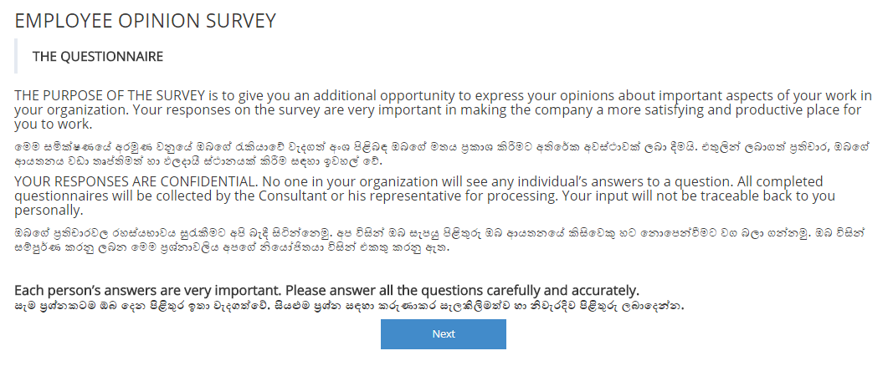
Online Employee Opinion Survey

Slide 13
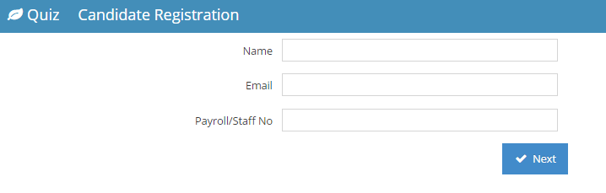
Online Employee Opinion Survey

Slide 14
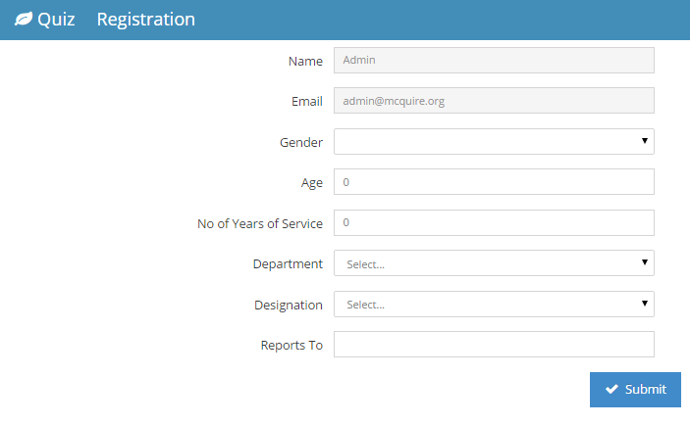
Online Employee Opinion Survey

Slide 15
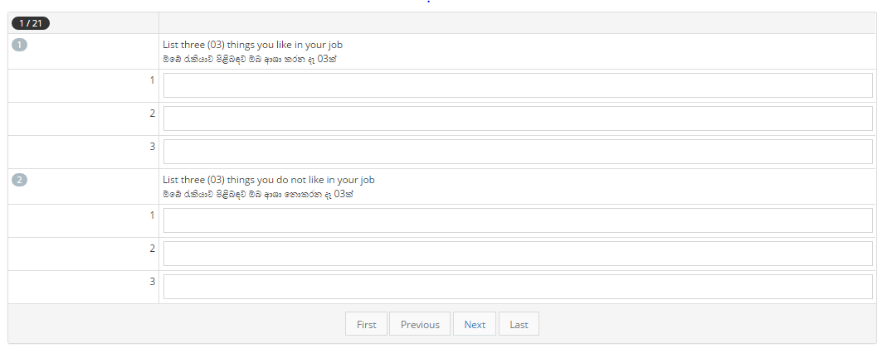
Online Employee Opinion Survey

Slide 16
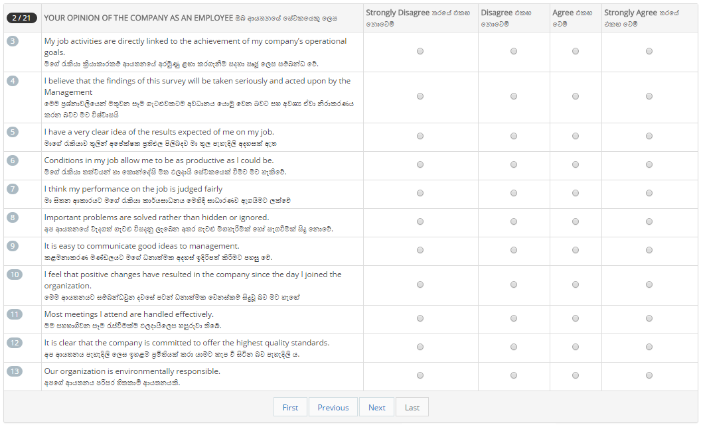
Online Employee Opinion Survey

Slide 17
Online Employee Opinion Survey
The Online Employee Opinion Survey can be customized in order to suit the local language of other countries.

Slide 18
HR Assignments
Upgrading and modernizing the organization charts
Employee profiling
Employee training needs identification
Scheduling for training
Introducing Performance based Employee Evaluation Scheme
Introduction of a Salary Structure

Slide 19

Marketing and Selling
Marketing Plan and strategy
Go-to-Market Models
Brand creation & development positioning
Modern marketing methods such as social media
Sales/Distribution/Planning
New selling strategies
Networking
Promotions
International Trading

Slide 20

Production
Investigation and comparison of production related process flow and suggesting improvements

Slide 21
Our Satisfied Clients

Slide 22
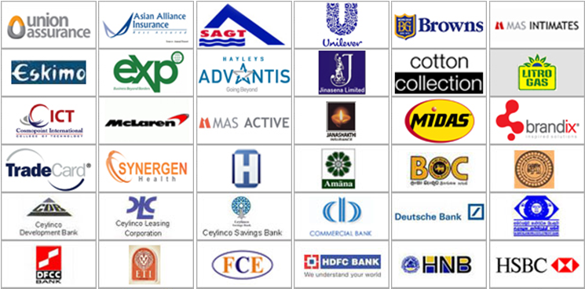

Slide 24
Dell
Sanofi
Coca Cola Beverages
Football Federation SL (under FIFA)
Pan Asia Bank
Sri Lanka Telecom
Airport & Aviation Sri Lanka
The Credit Information Bureau of Sri Lanka
Penguin
Emerald
Dilmah
Colombo Stock Exchange
Ernst & Young
KIA Motors
Entrust
Dialog
Bank of Maldives

